Slide 1
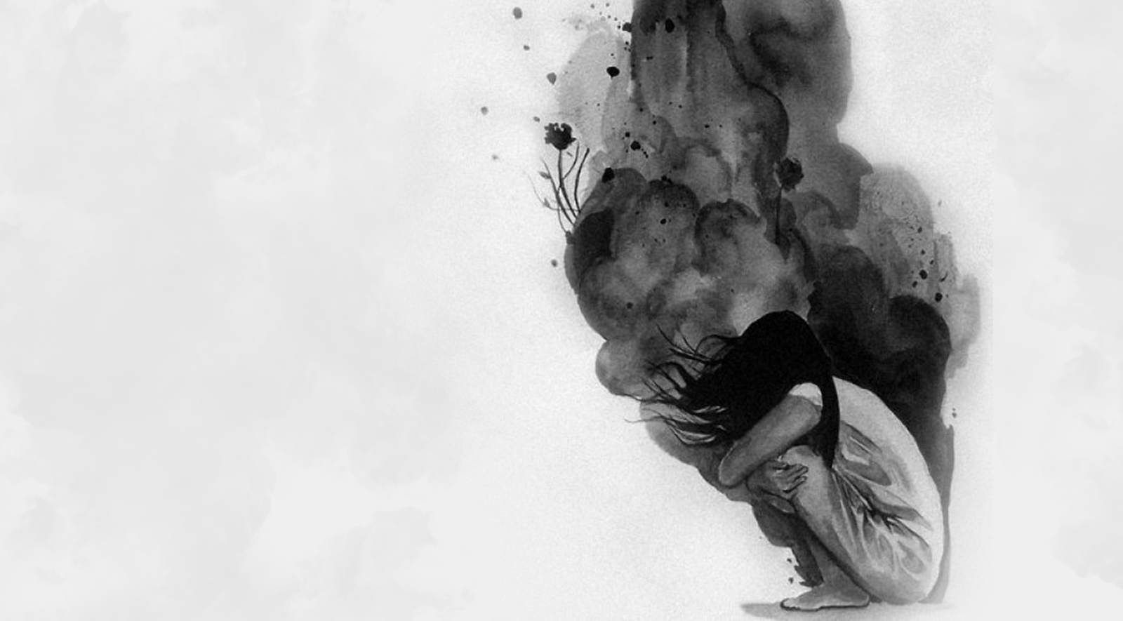
DEPRESSION AMONG UNIVERSITY STUDENTS
Umamah hussain 21L-1858
Faiqa malik 21l-1865
Moeez ali 21l-1798
Yousaf Zahid 21l-5190

Slide 2
WHAT IS DEPRESSION?
A common and serious medical illness.
Loss of interest in activities you once enjoyed.
Causes variety of emotional and physical problems.
Decreases your ability to function properly.

Slide 3
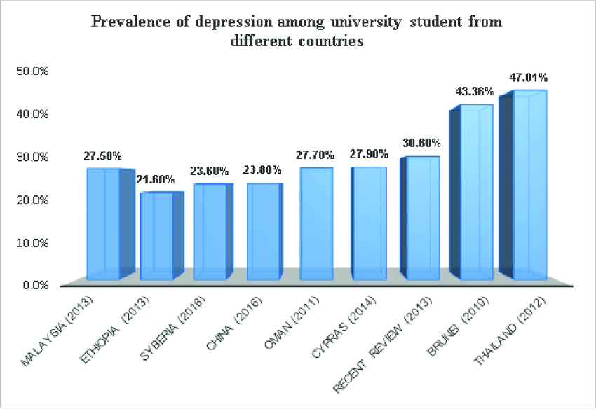

Slide 4
SYMPTOMS
Changes in appetite — weight loss or gain unrelated to dieting
Trouble sleeping or sleeping too much
Feeling worthless or guilty
Loss of energy or increased fatigue
Thoughts of death or suicide

Slide 5

MAJOR CAUSES OF DEPRESSION.
Financial issues.
Unsupportive parents.
Education system of the country.

Slide 6
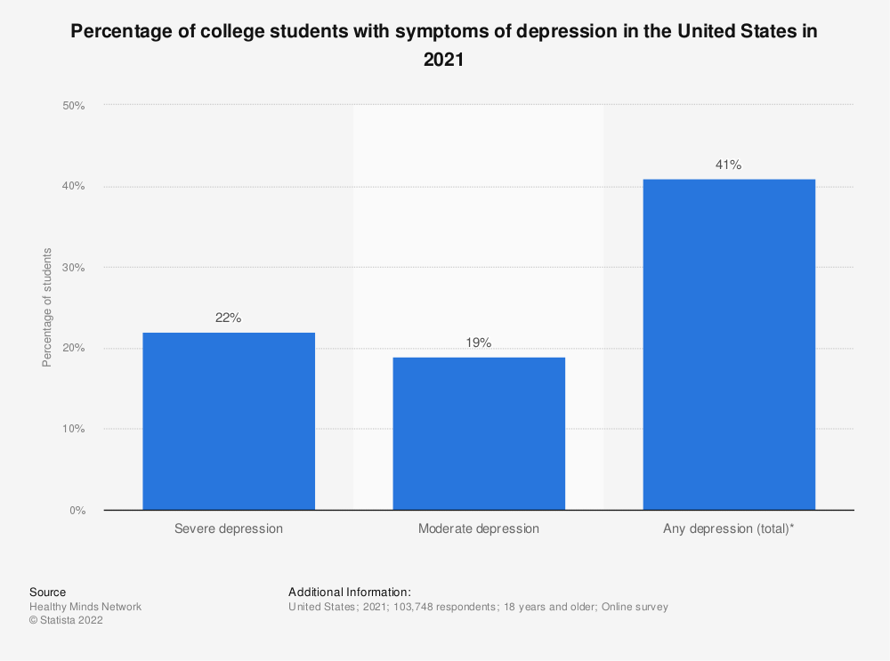

Slide 7
FINANCIAL ISSUES
Cannot get into dream universities
Need to find jobs to continue studies
Hectic timetables
Cannot keep up with studies & work

Slide 8
UNSUPPORTIVE PARENTS
No friendly bond between parents & children
Compare their lives
Don’t support us during our failures
Constantly demand more

Slide 9
EDUCATION SYSTEM
Efforts for getting into dream institute
Students of diverse cultures treated same
Decayed marking system
Uncertainty about future

Slide 10
EDUCATION SYSTEM
Academic achievement
Parental pressure
Unnecessary burden of studies
Not enough extra curriculars and physical activity

Slide 11
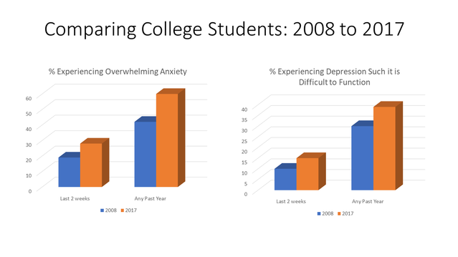
DEPRESSION IN 2008 VS 2017

Slide 12
POSSIBLE SOLUTIONS
Normalize seeking professional help
Destigmatize with the help of media
Government should provide more helpful avenues
Educate adults on how to help.
Appoint psychiatrists in all academic institutions

Slide 13
CONCLUSION
Depression is a serious mental health issues
Various symptoms like loss of appetite and fatigue
Discussed major causes
Possible solutions and how to overcome it.

Slide 14
THANK YOU!!

